Slide 1

Hybrid Parallelization Strategy for the NEMO Ocean Model
S. Mocavero, I. Epicoco
NEMO System Team - CMCC

Slide 2

Goal
Evaluating different hybrid parallel approaches for many-core architectures:
Reducing the communication time
Exploiting the shared memory
Exploiting the memory hierarchy
The considered test case is the routine implementing the MUSCL advection scheme.

Slide 3
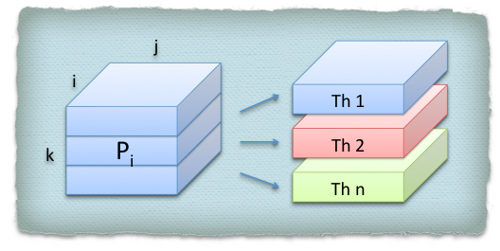
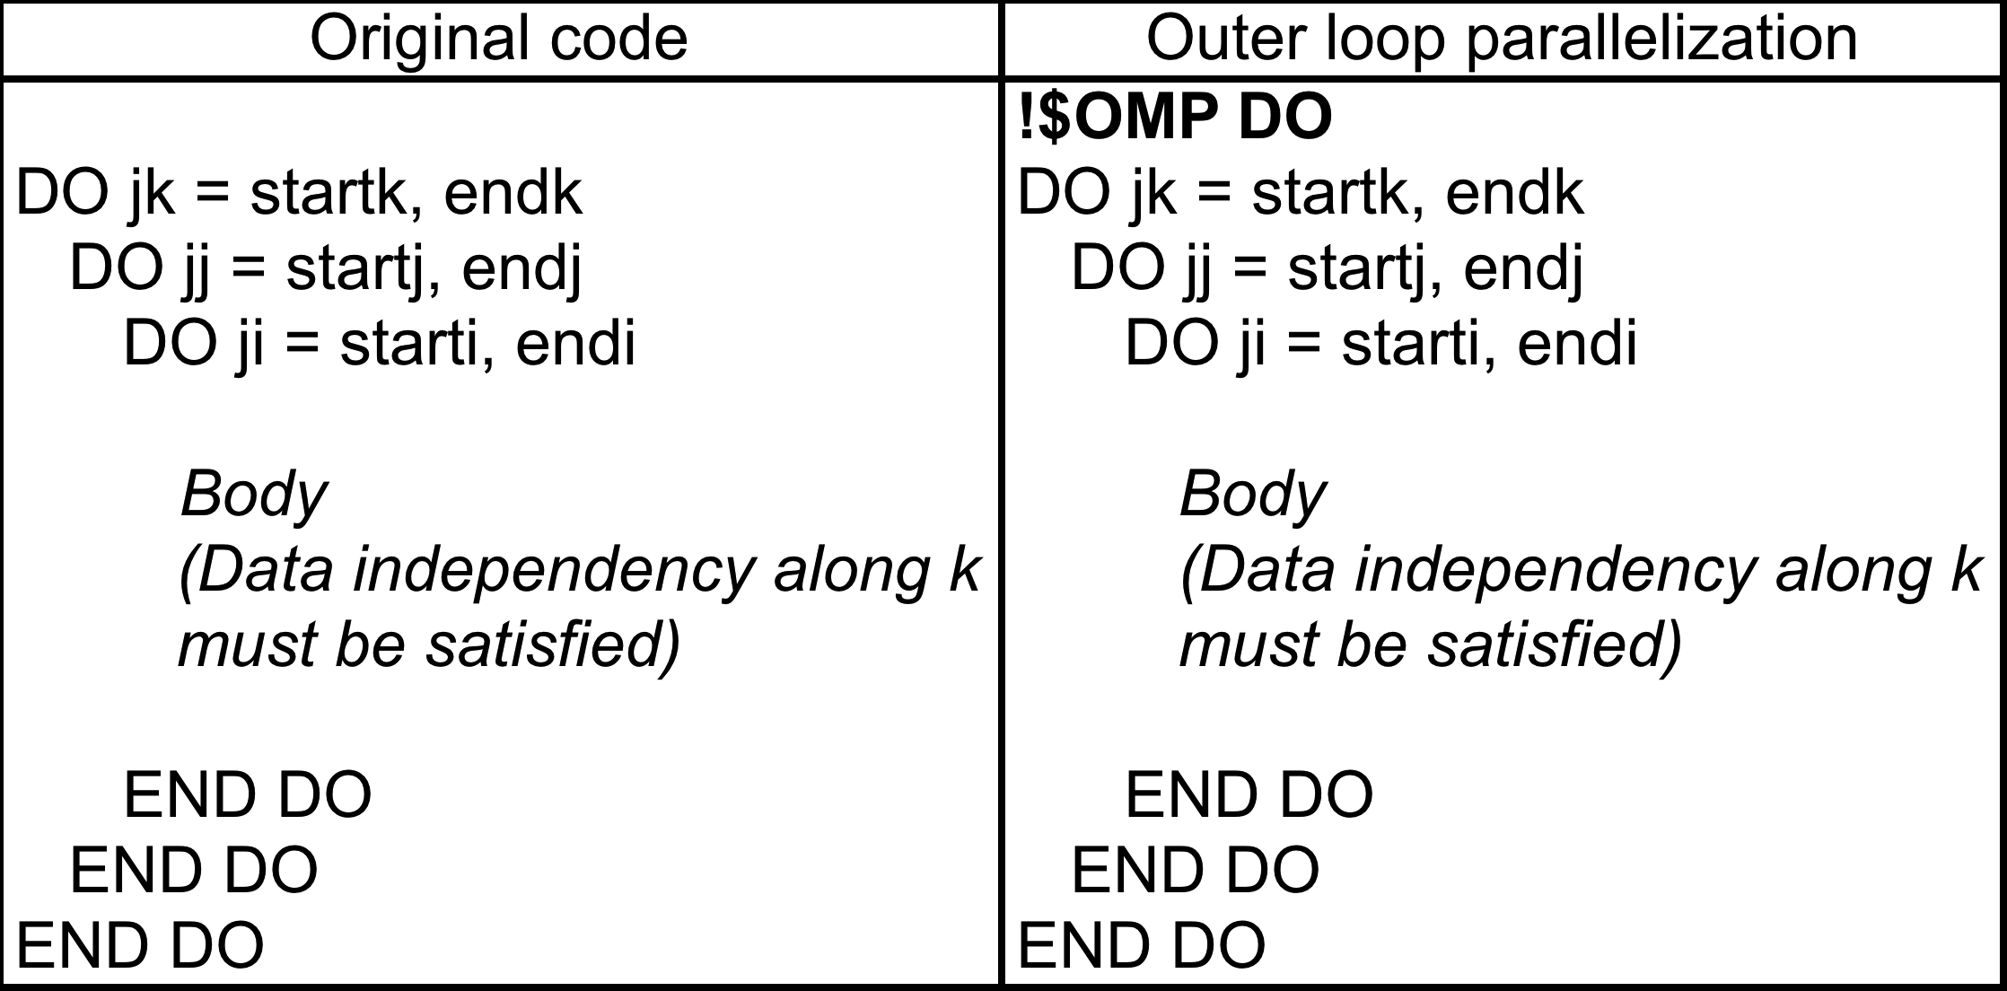
Outer loop parallelization
Only the outer loop is distributed among the parallel threads:
PROs:
It is extremely simple to implement
It introduces minimum amount of parallel overhead
CONs:
- The parallelism is limited to the number of iterations characterizing the outer loop (never greater then 100 for the k direction, reaching 2000 for the j direction, but the number of 2D loops is fewer then 3D)

Slide 4
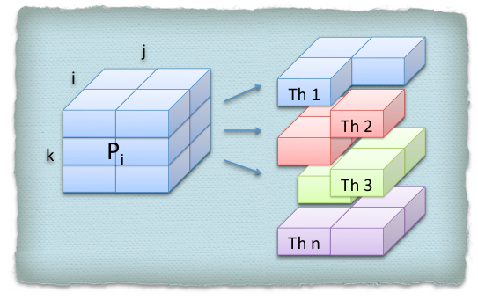
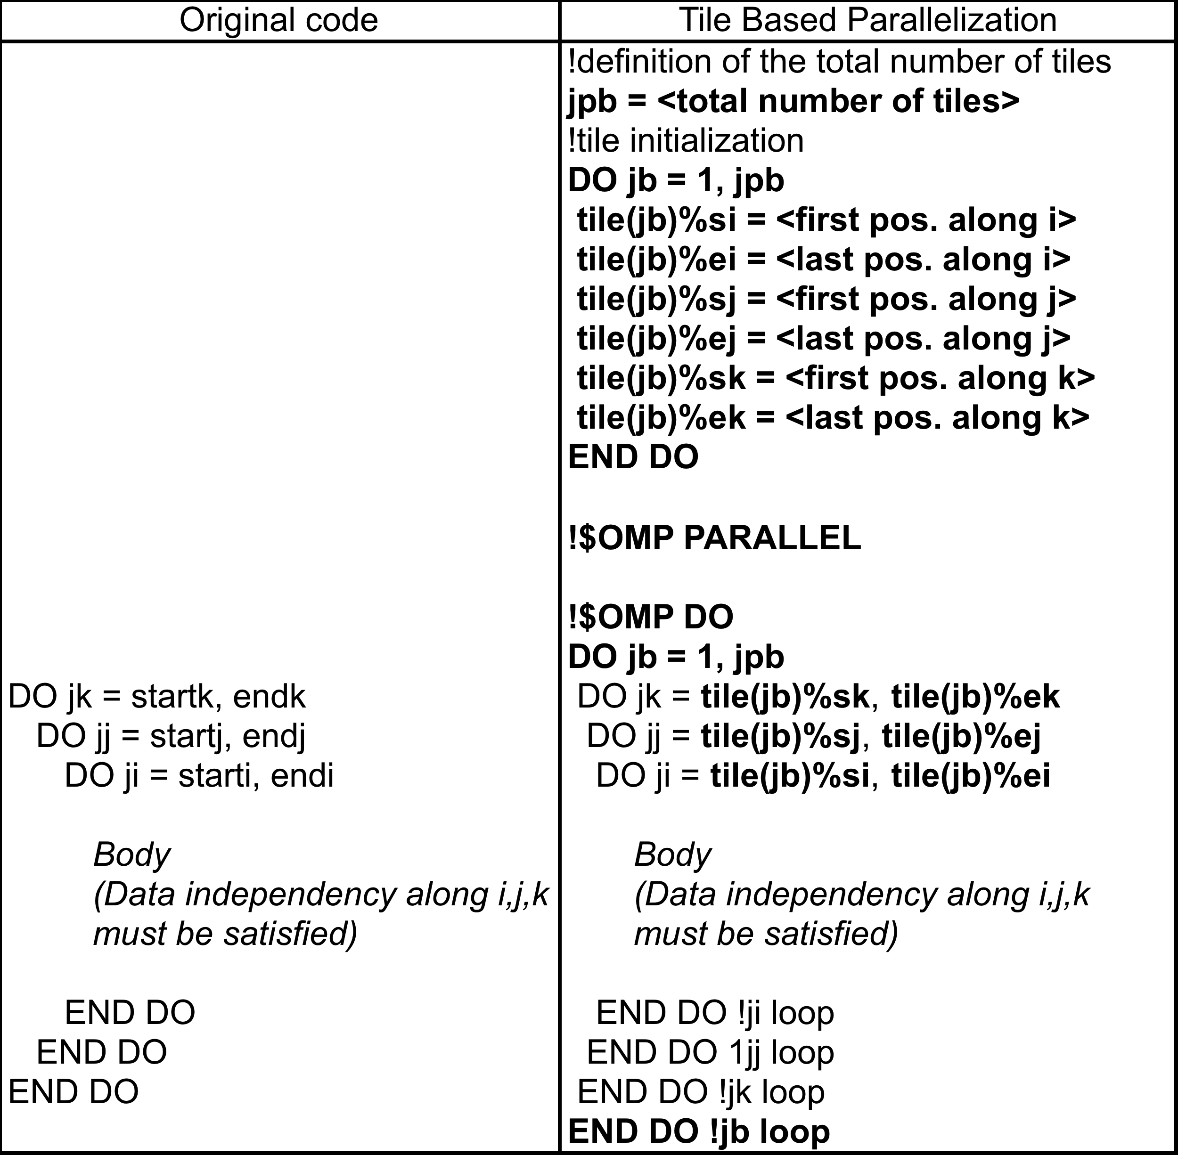
Tile based paralleization
Each MPI sub-domain is divided into 3D tiles; the available tiles are distributed among the parallel threads
PROs:
It allows a fine grained parallelism (up to a single grid point)
CONs:
- The cache misses are greater since the approach does not preserve a contiguous memory access

Slide 5
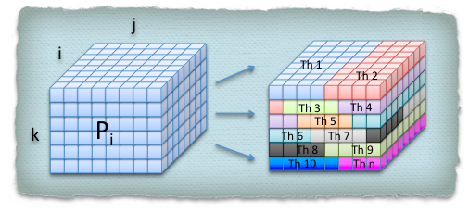
Loops Merge parallelization
The 3 nested loops are merged together and all of the iteration are distributed among the threads
PROs:
It allows a fine grained parallelism (up to a single grid point)

Slide 6
Architectures

Slide 7
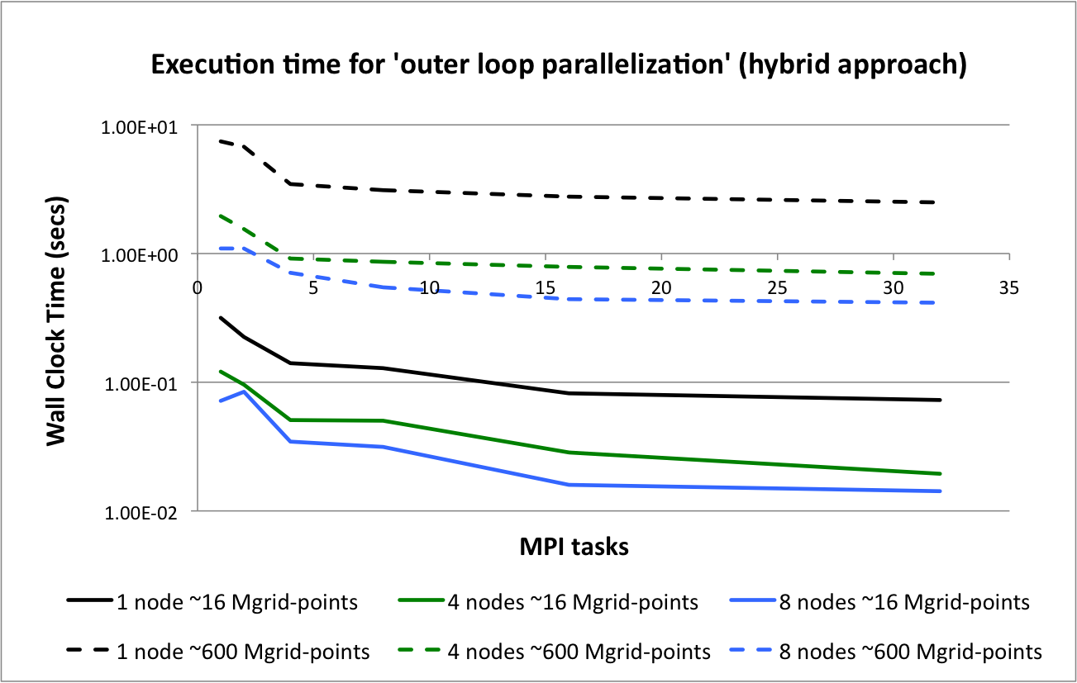
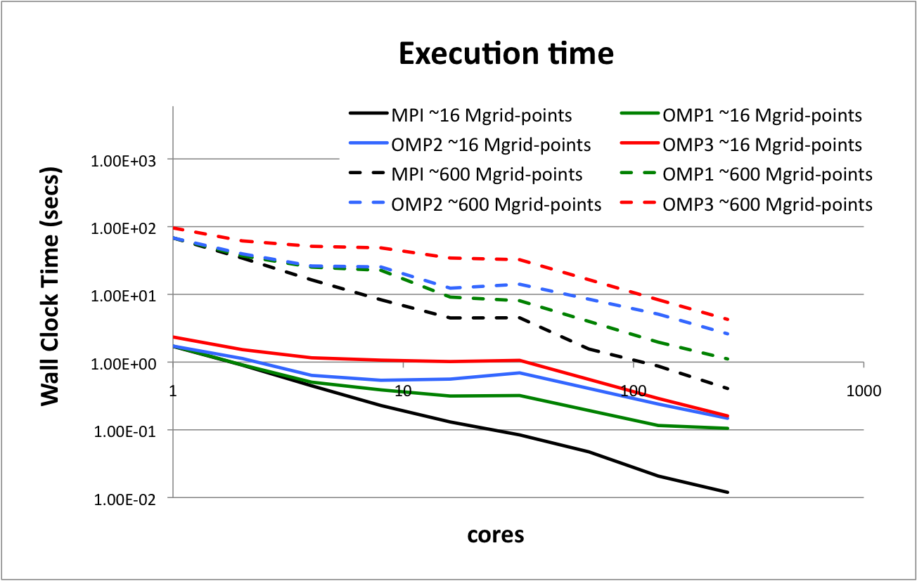
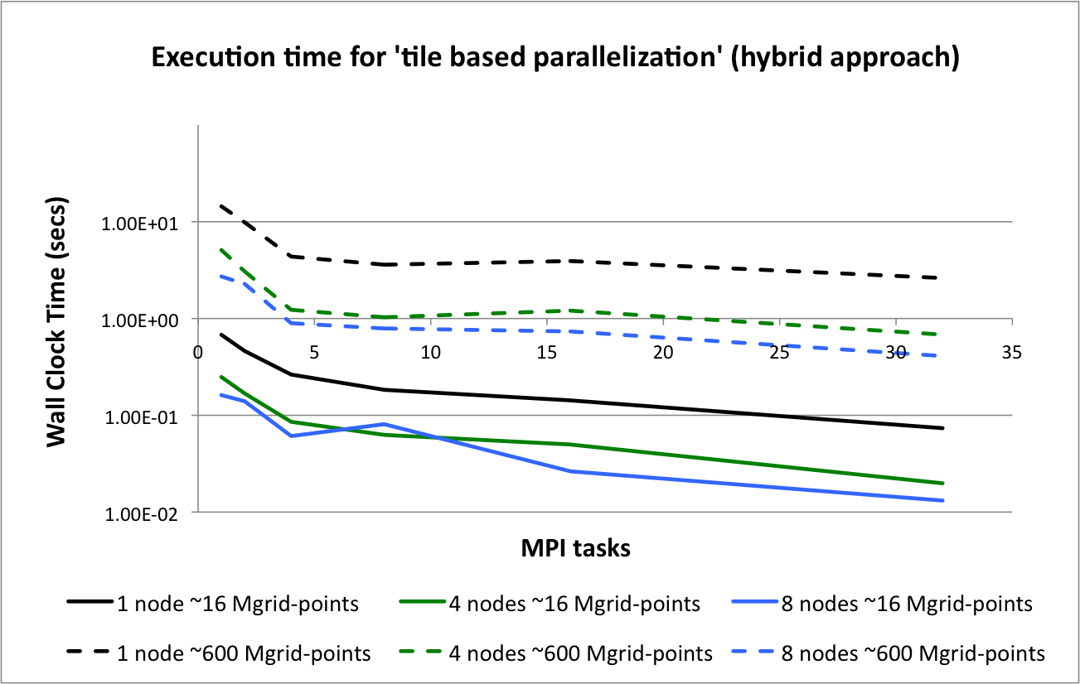
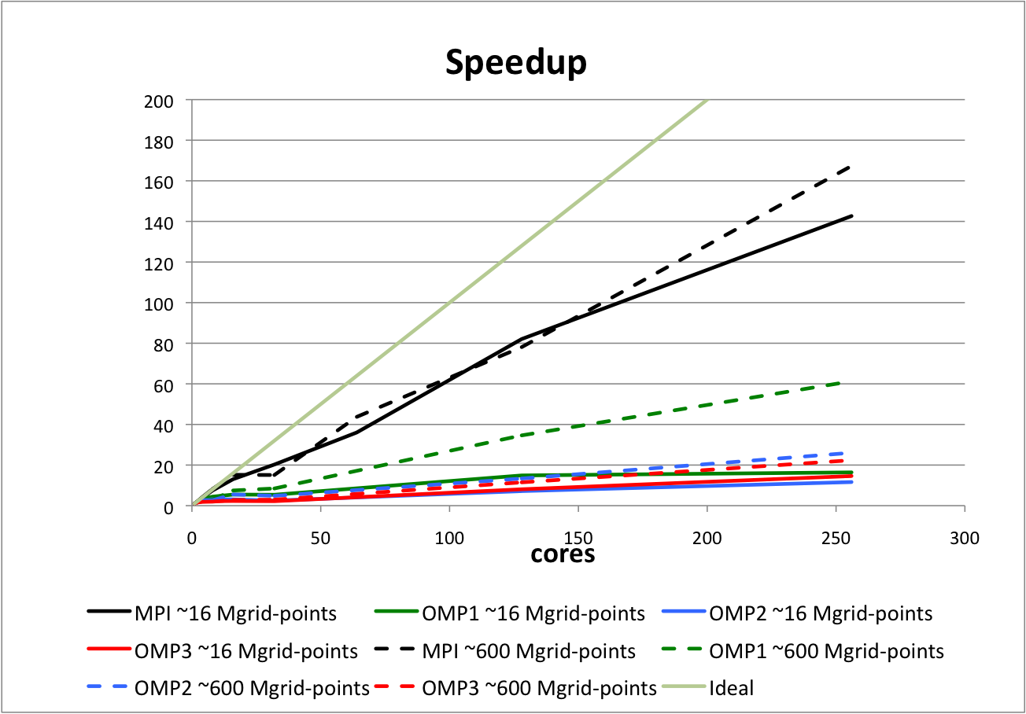
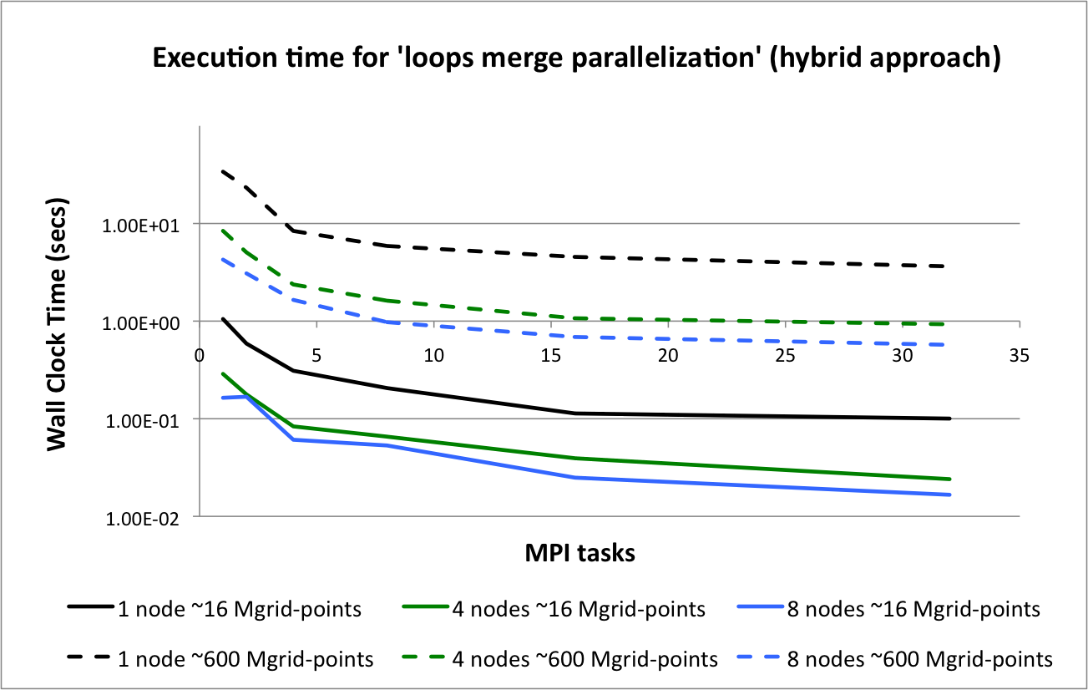
Results on IBM P6 – Calypso at CMCC

Slide 8
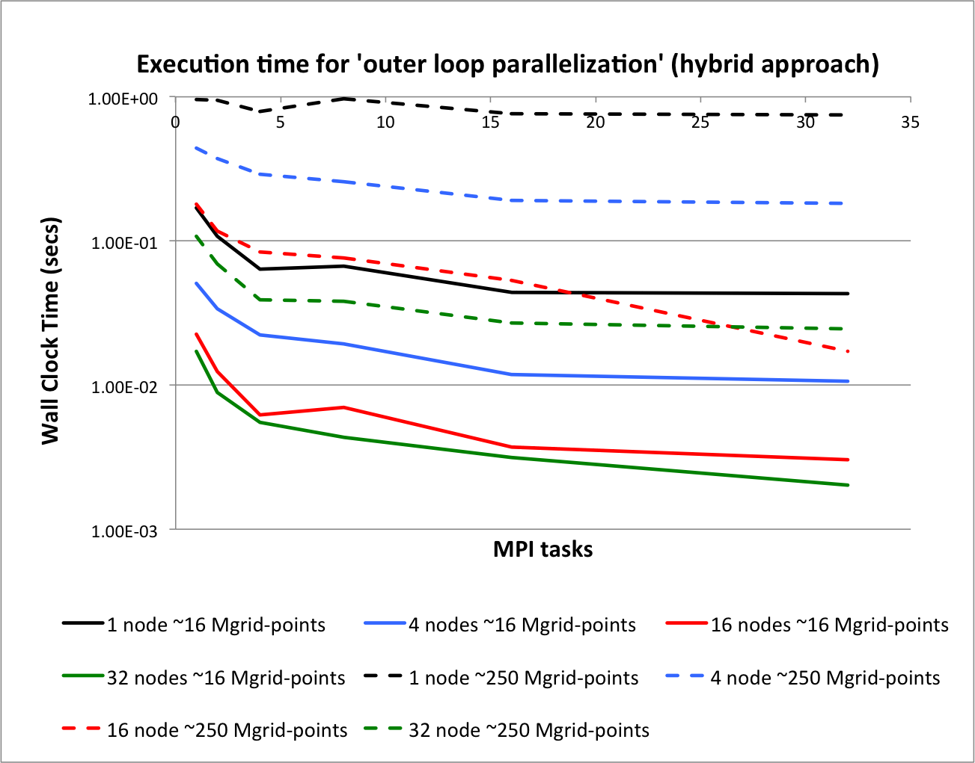
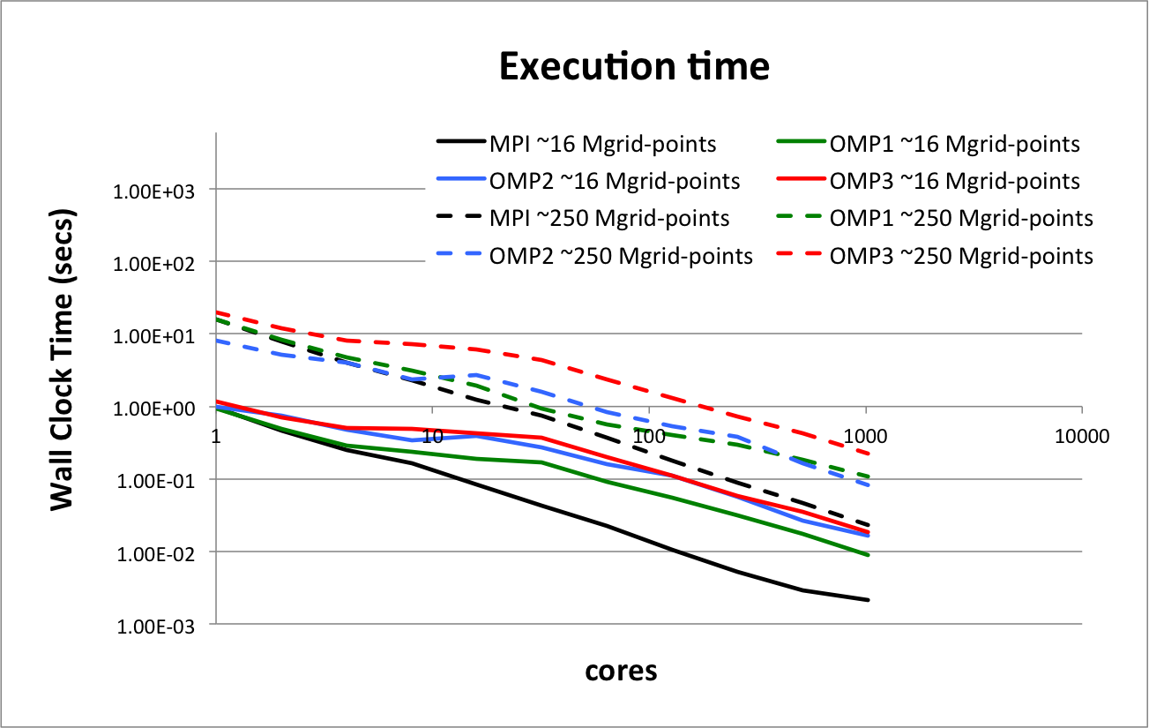
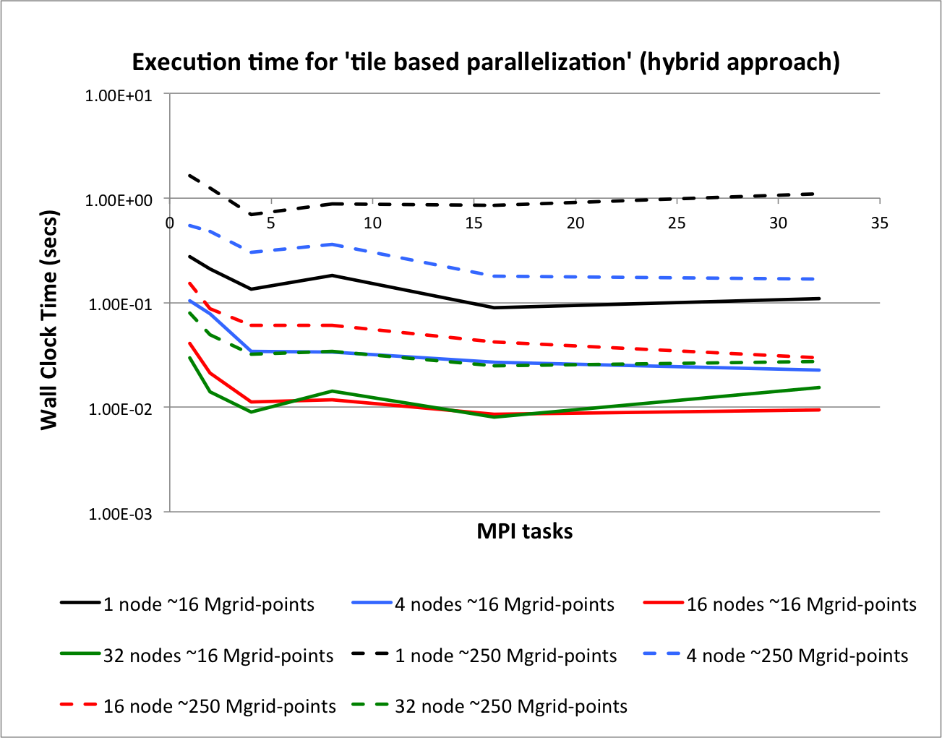
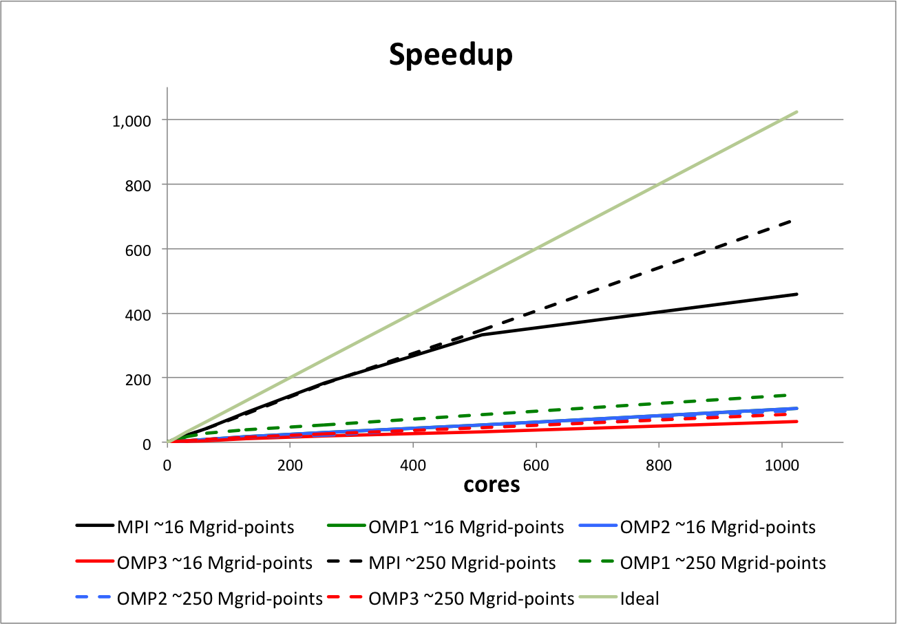
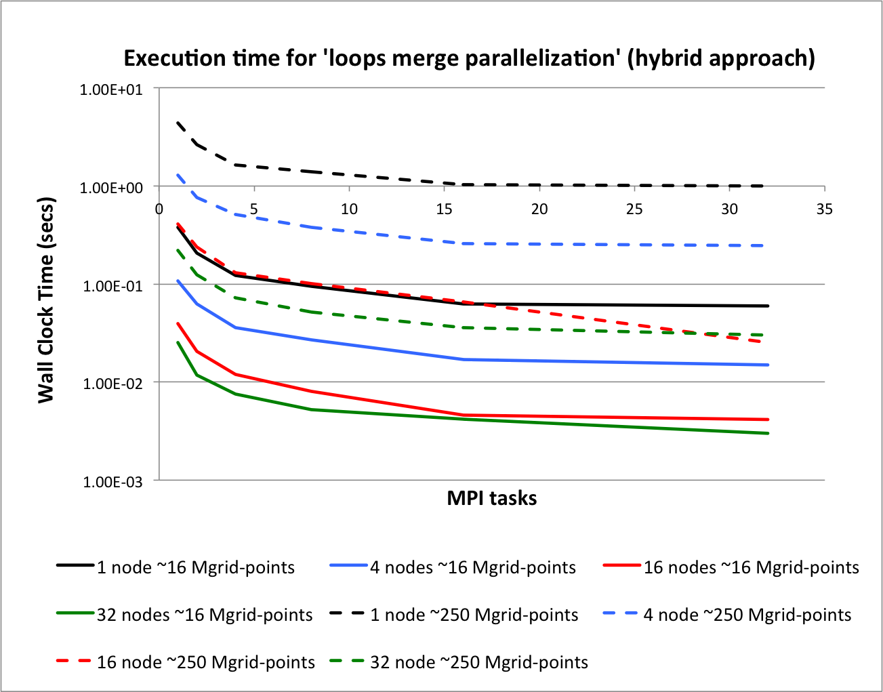
Results on IBM P7 – at ECMWF

Slide 9
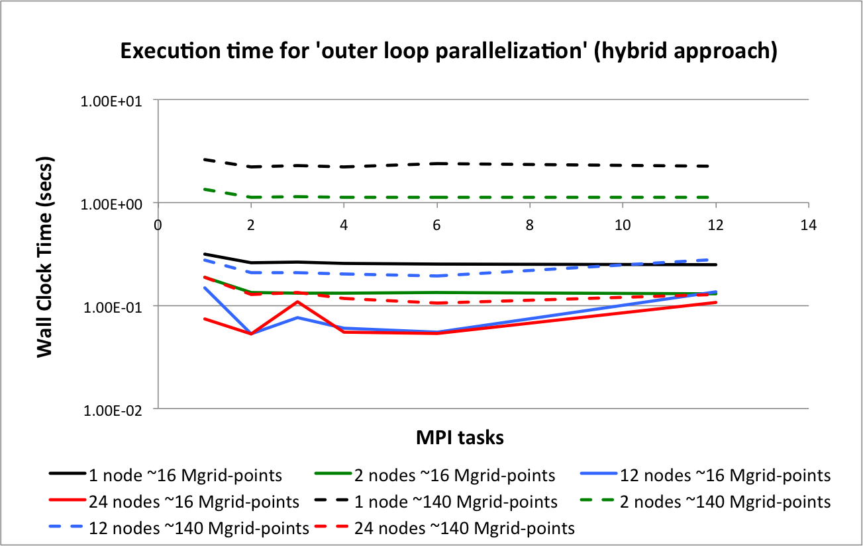
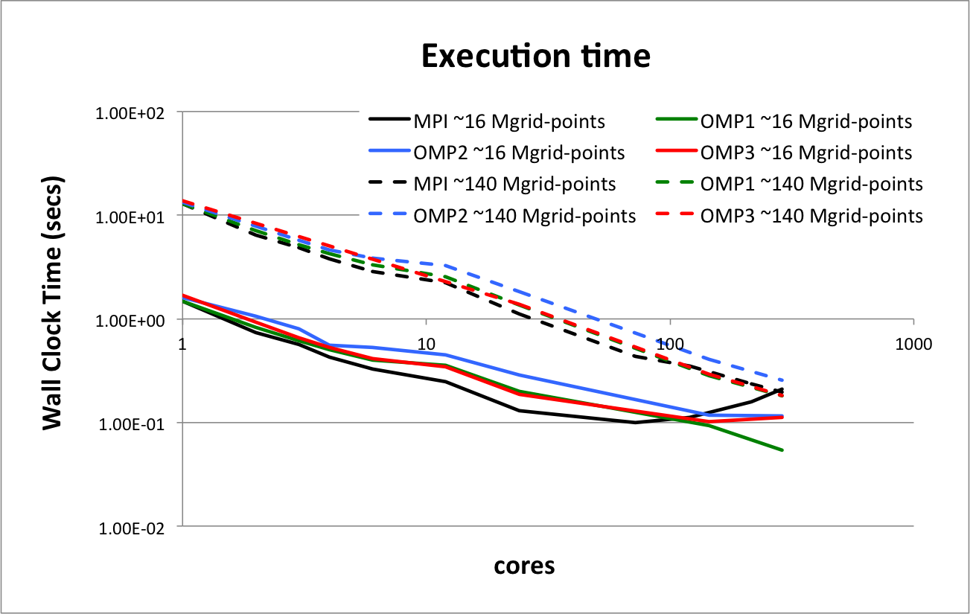
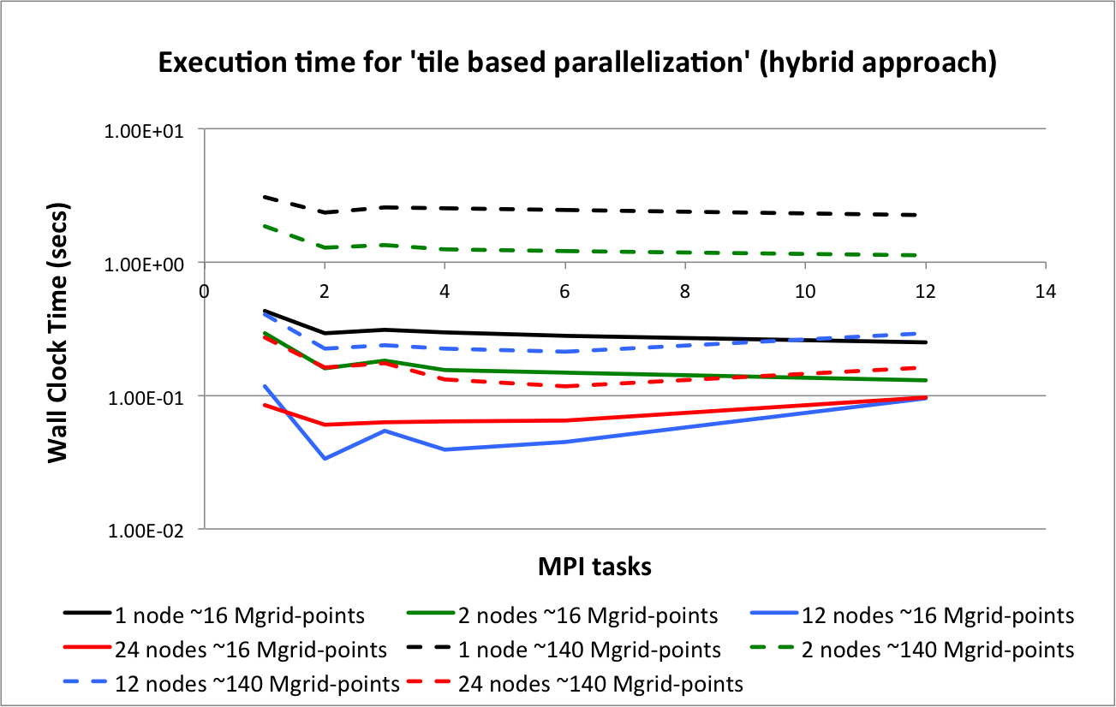
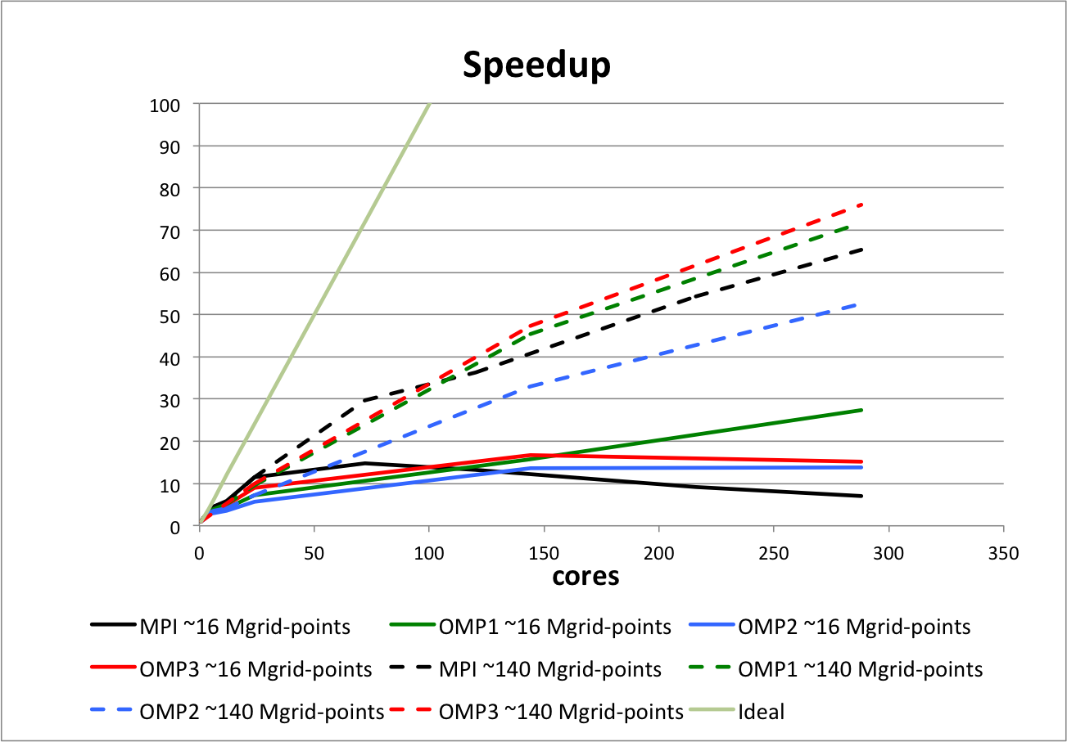
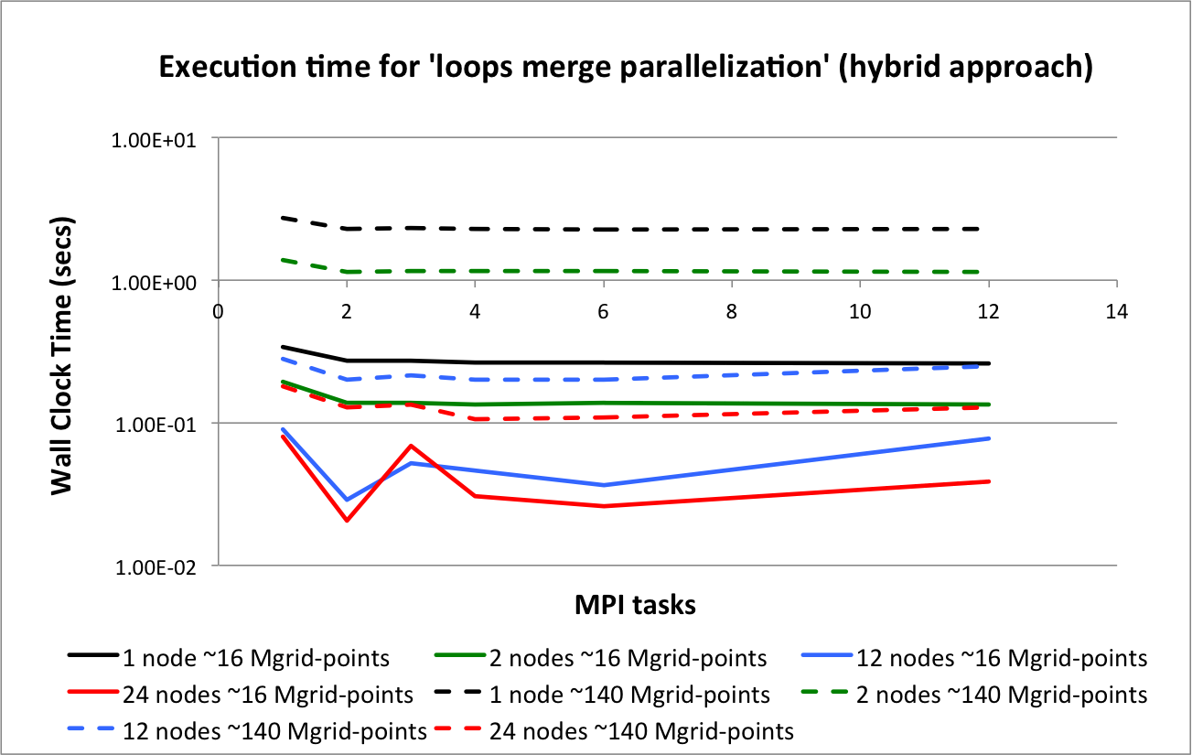
Results on IBM iDataPlex (Westmere)– PLX at CINECA

Slide 10
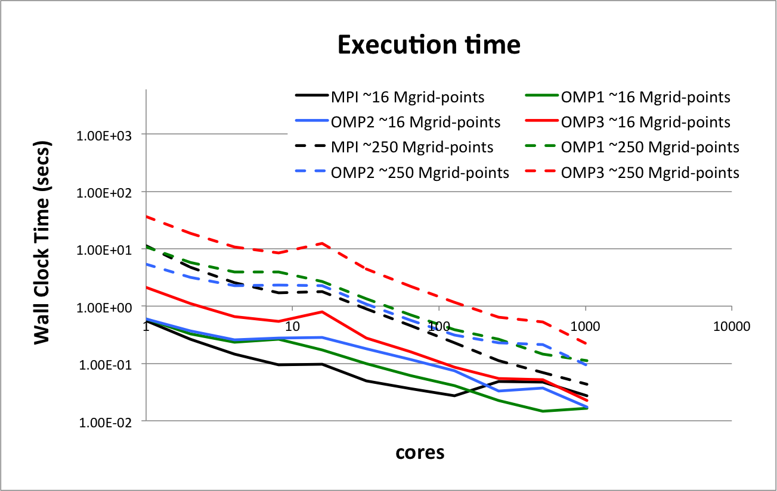
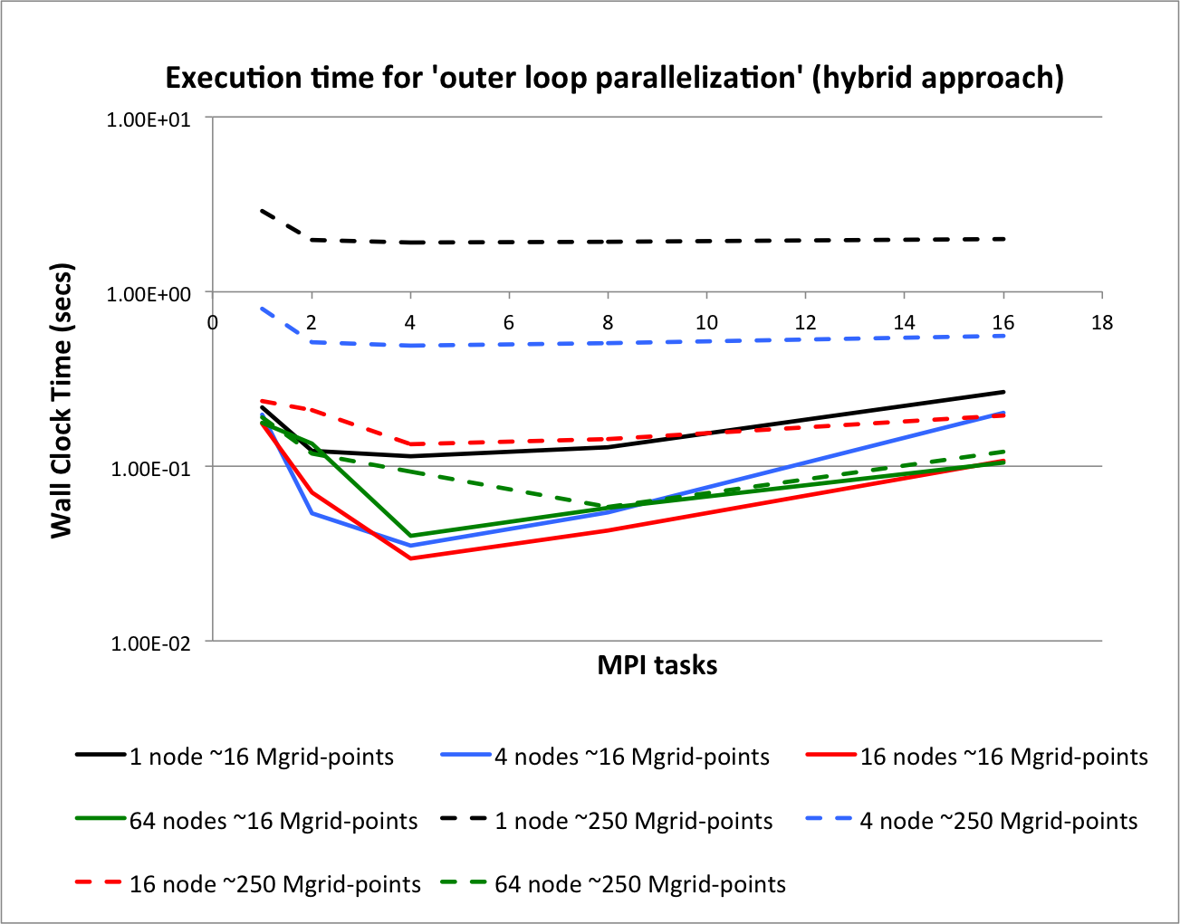
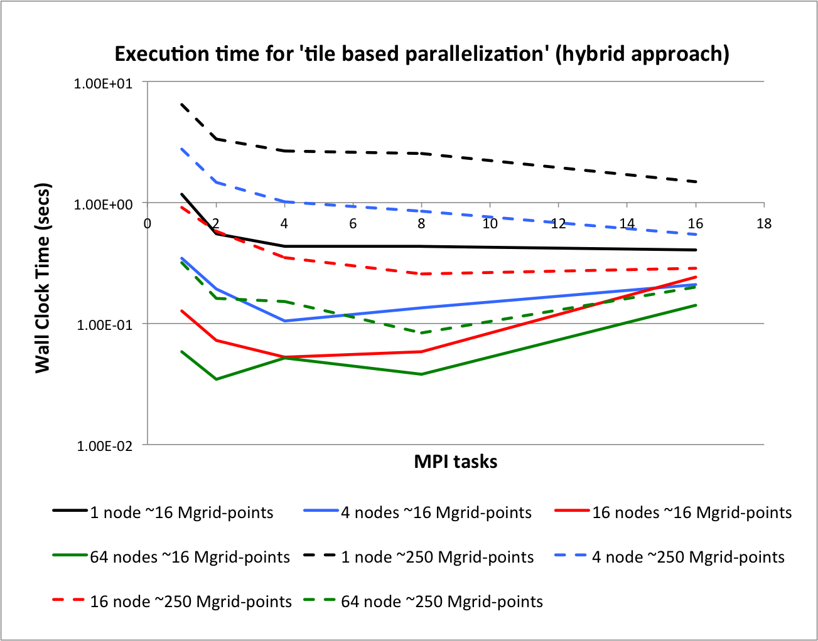
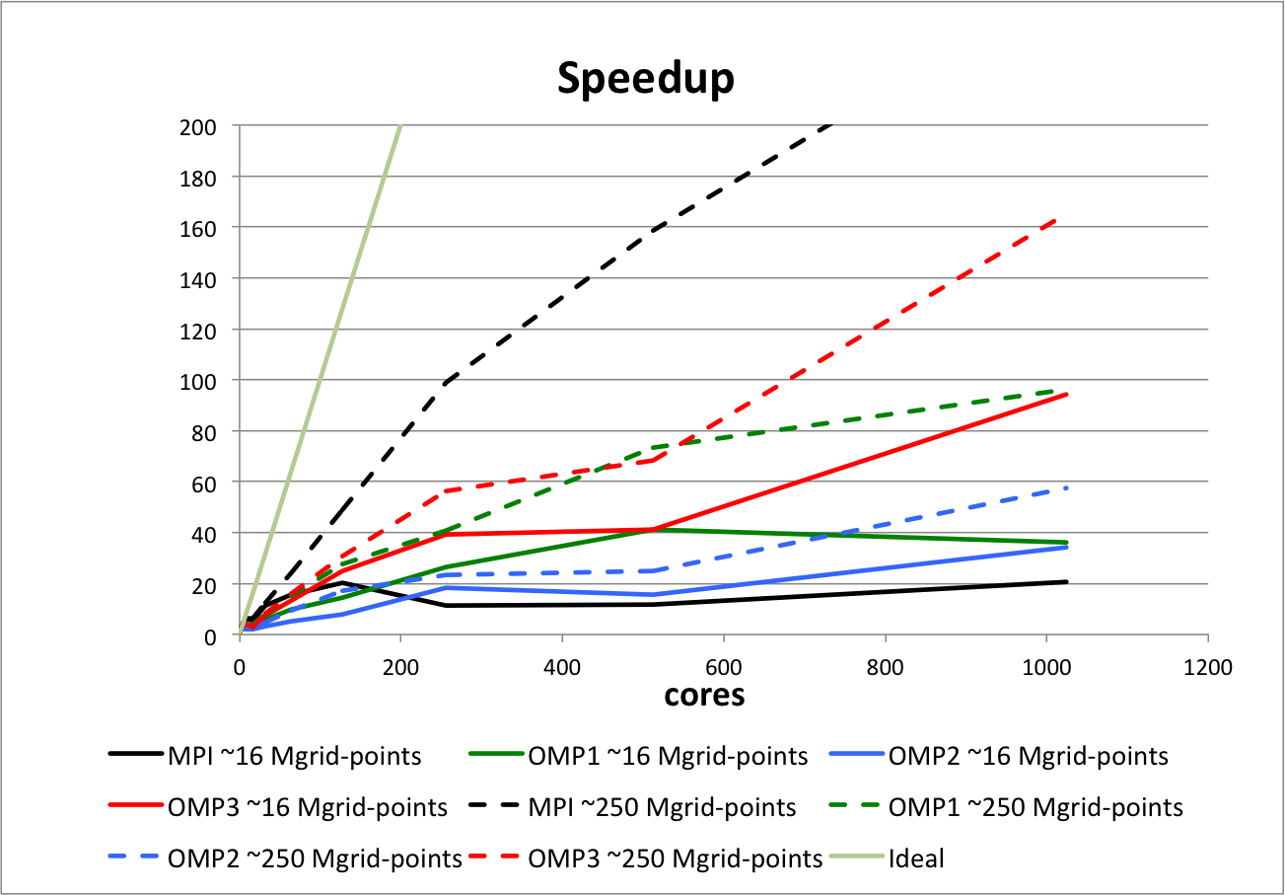
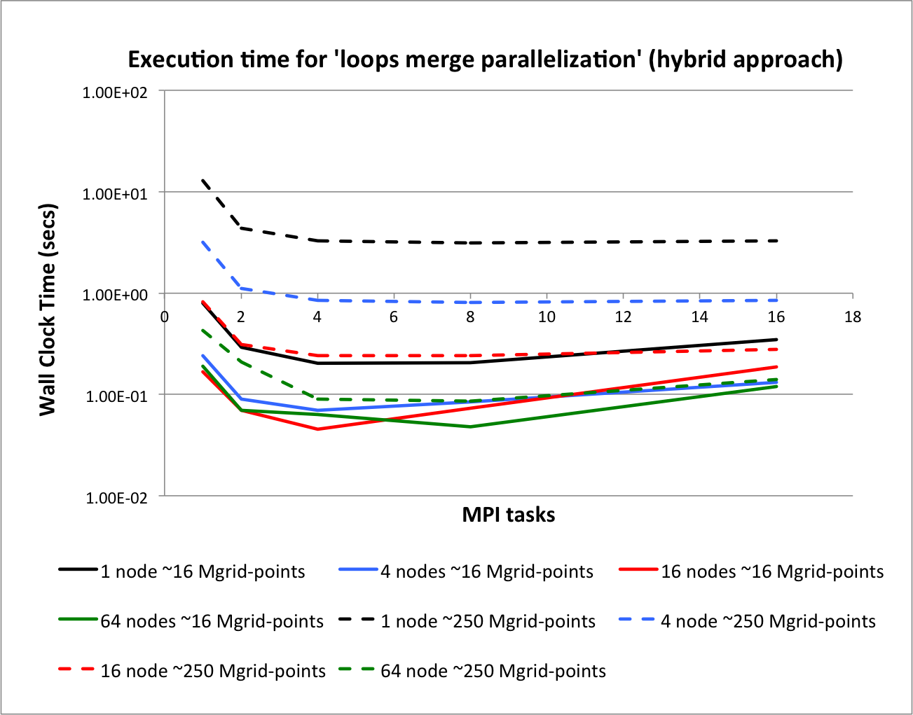
Results on IBM iDataPlex (SandyBridge) – Athena at CMCC

Slide 11
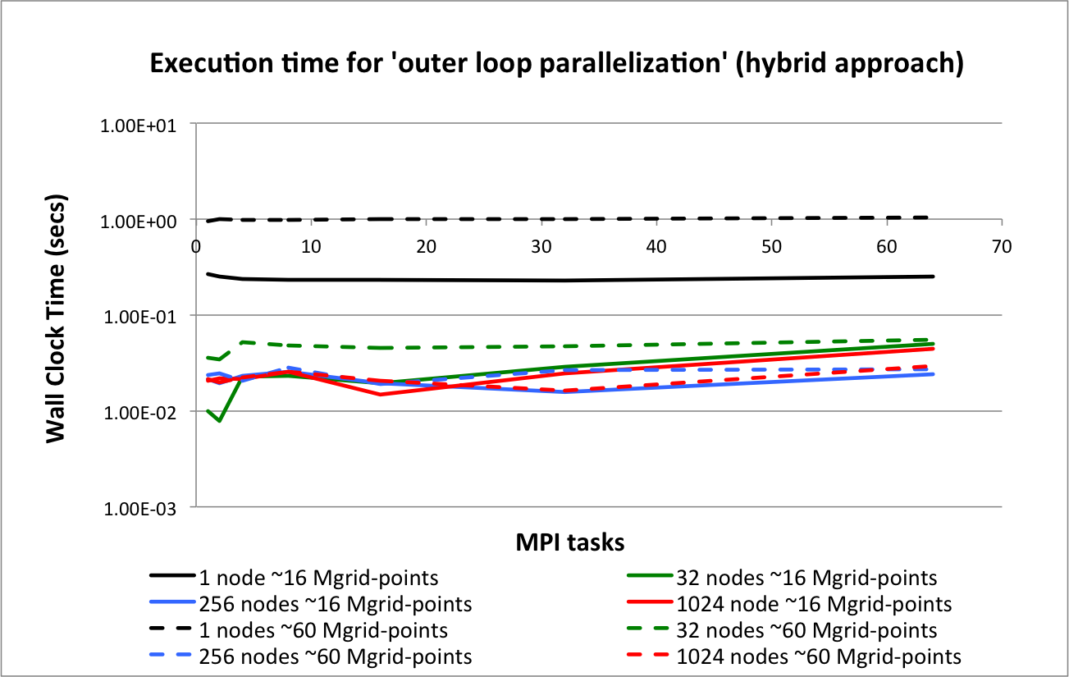
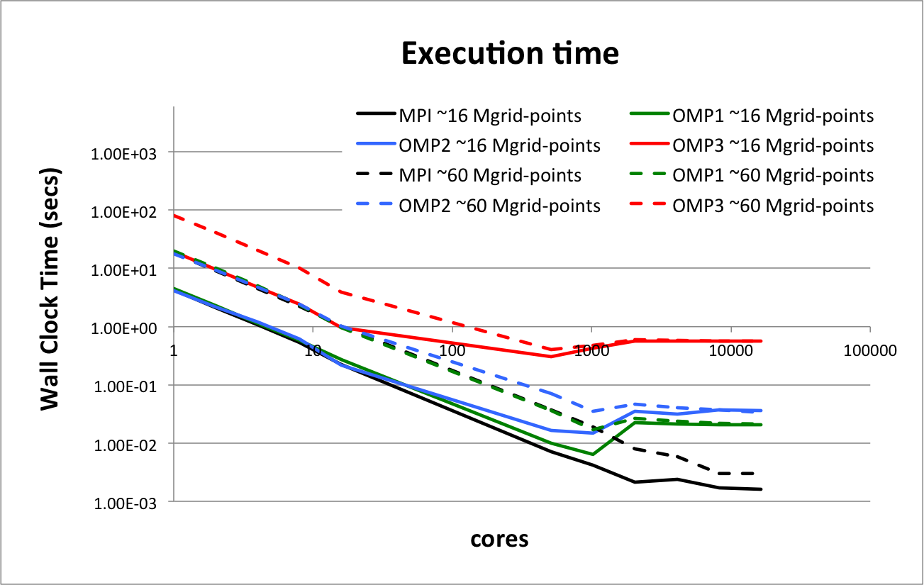
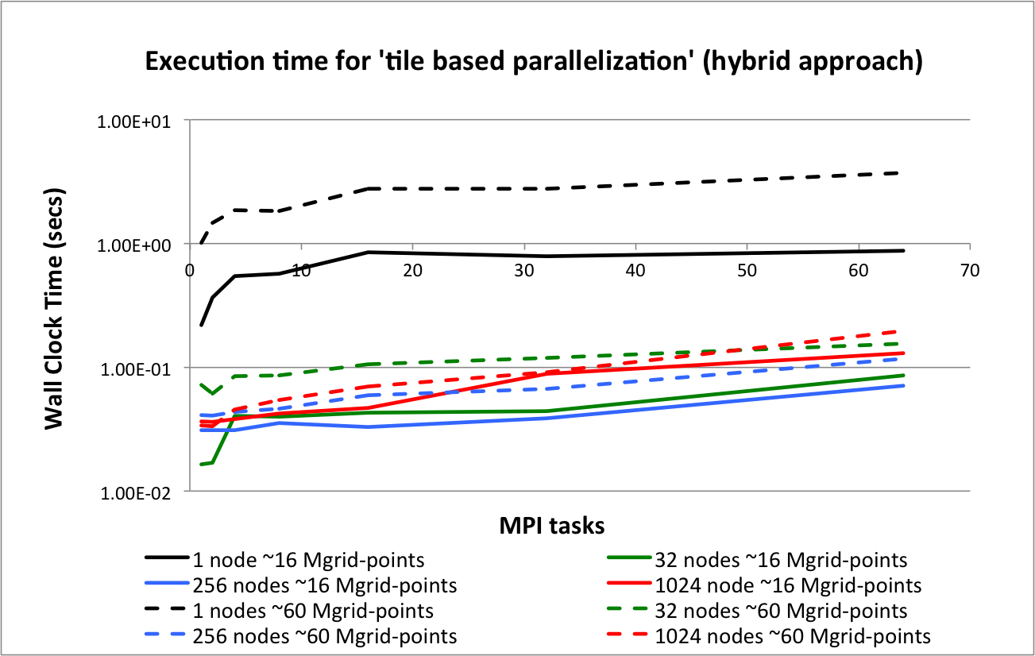
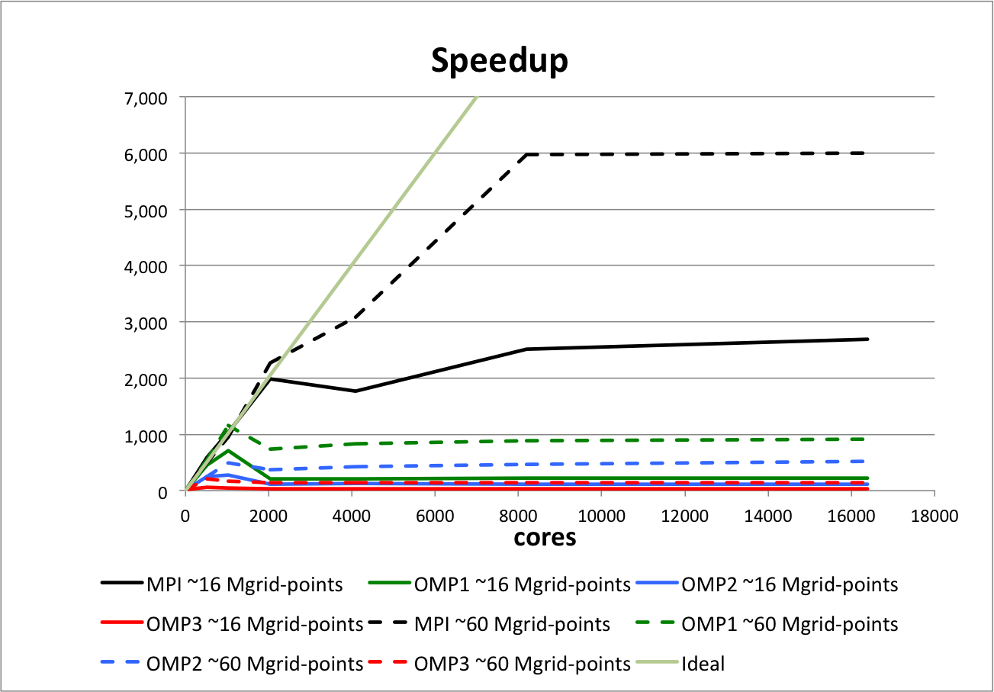
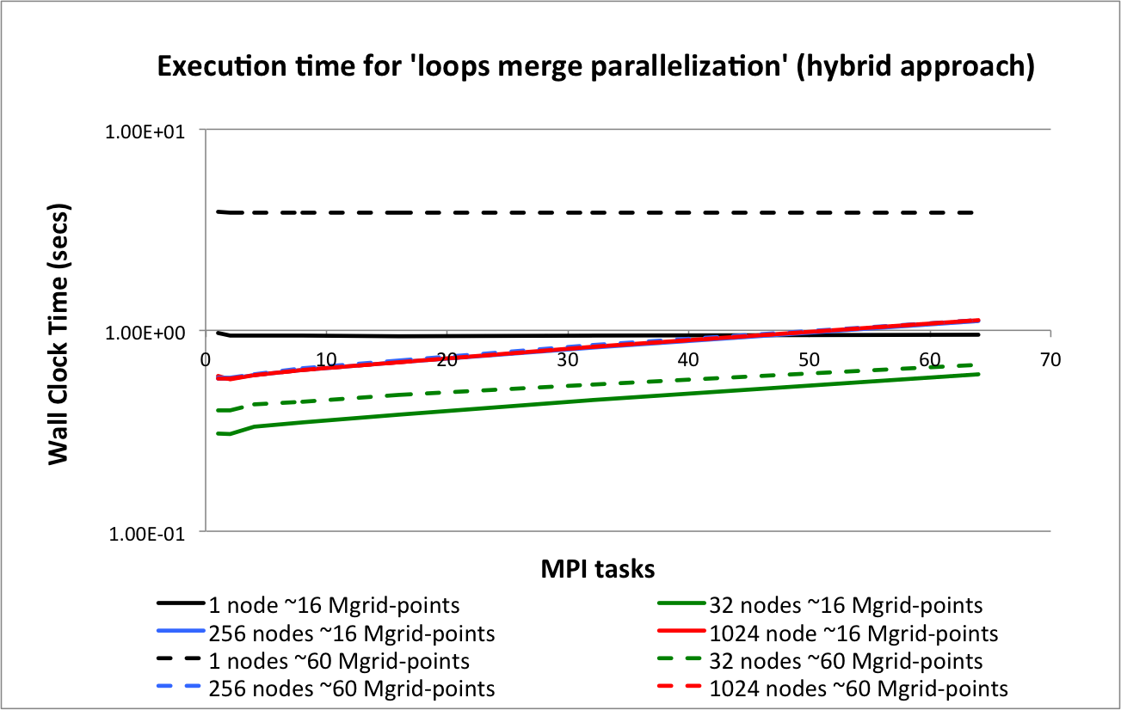
Results on BG/Q – Vesta at ARGONNE

Slide 12
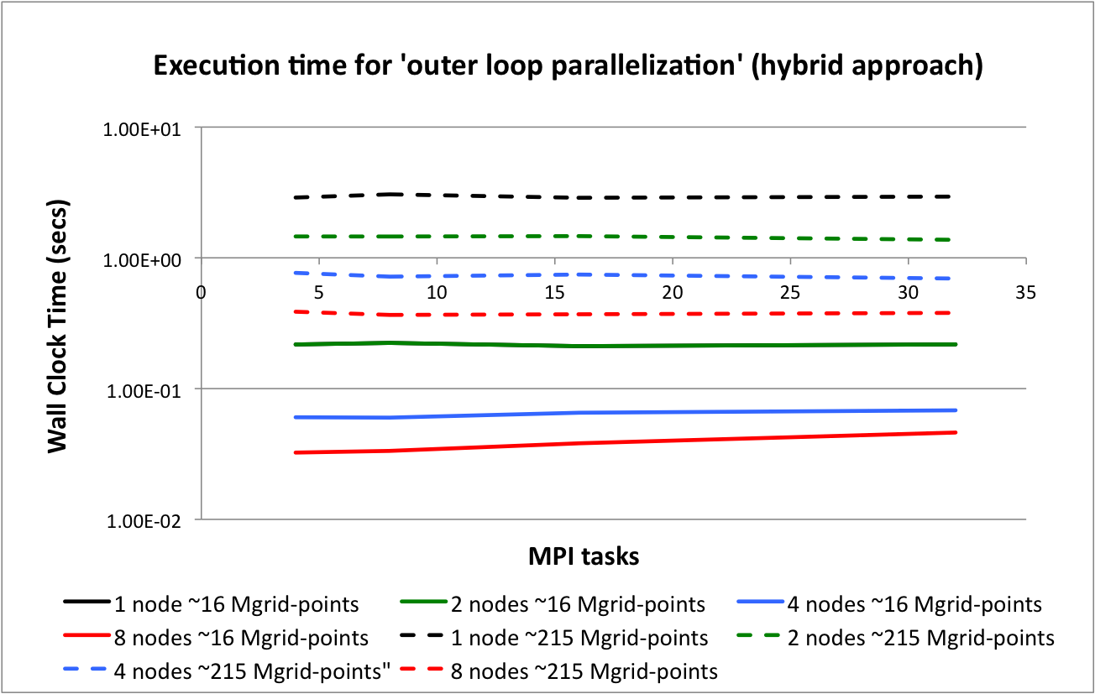
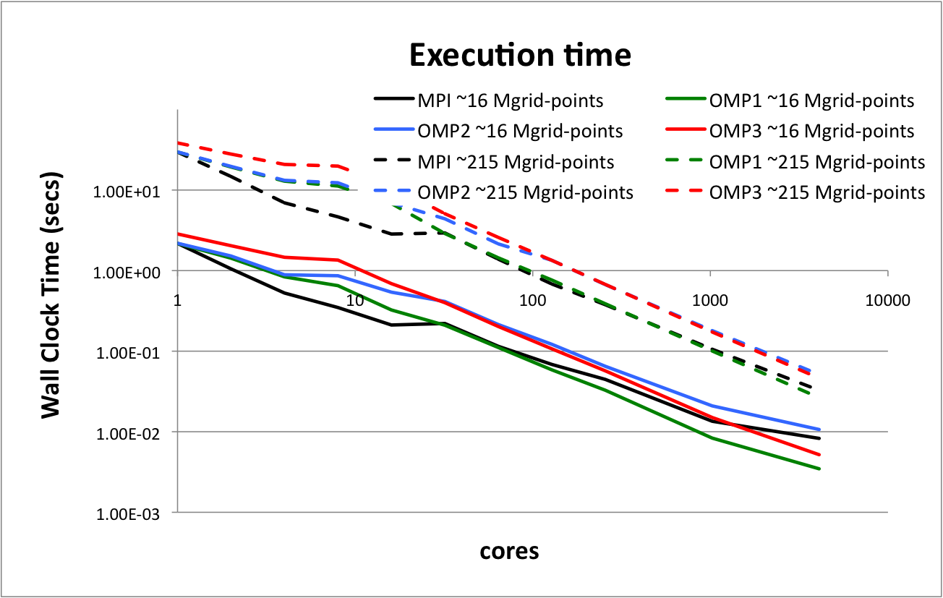
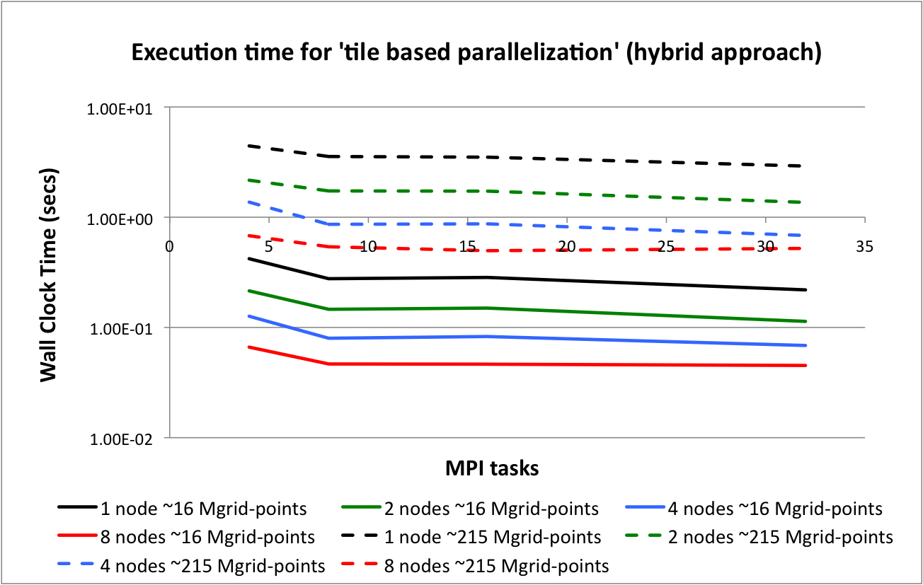
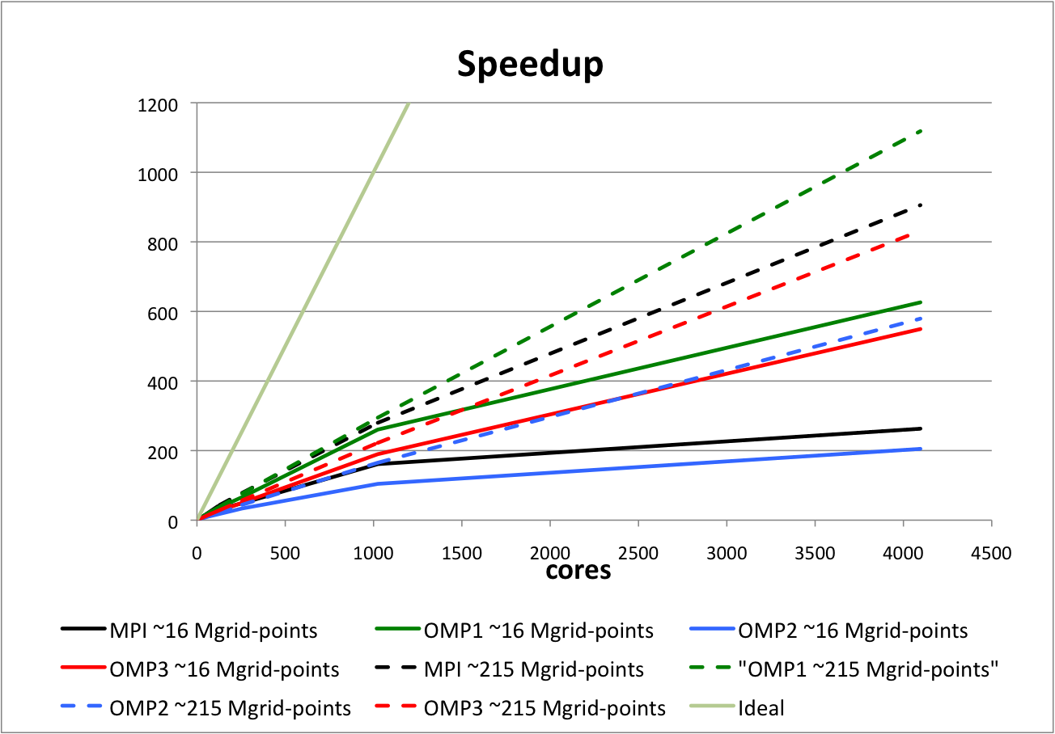
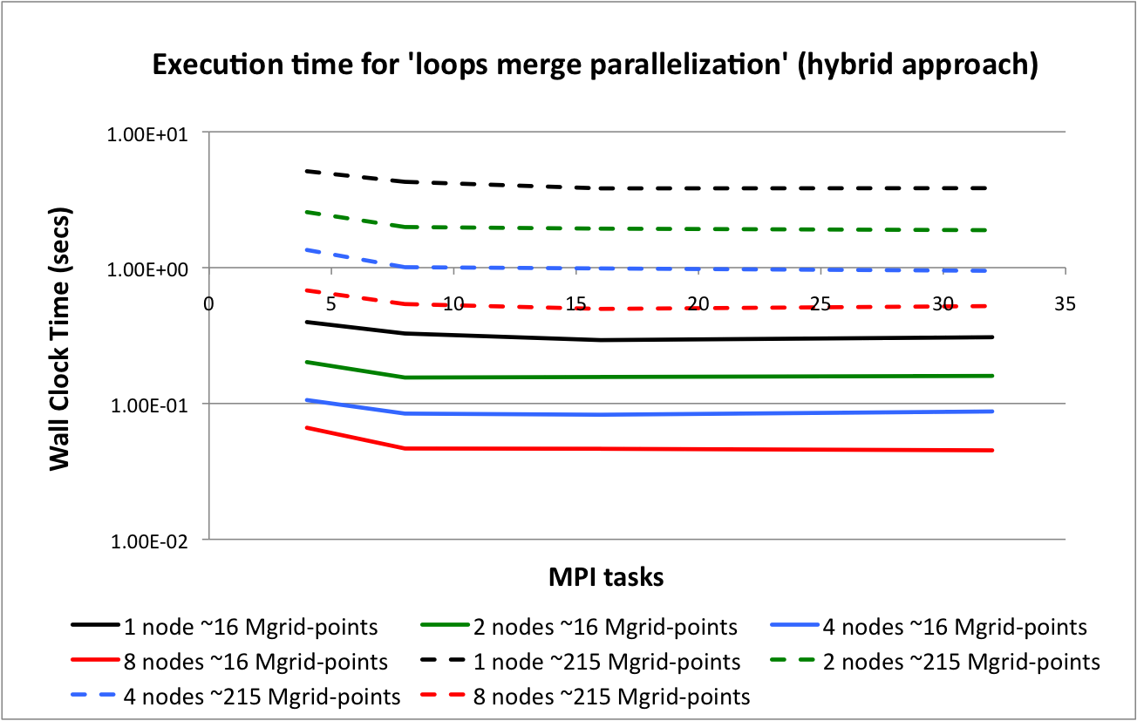
Results on CRAY XE6 – HECToR at STFC

Slide 13
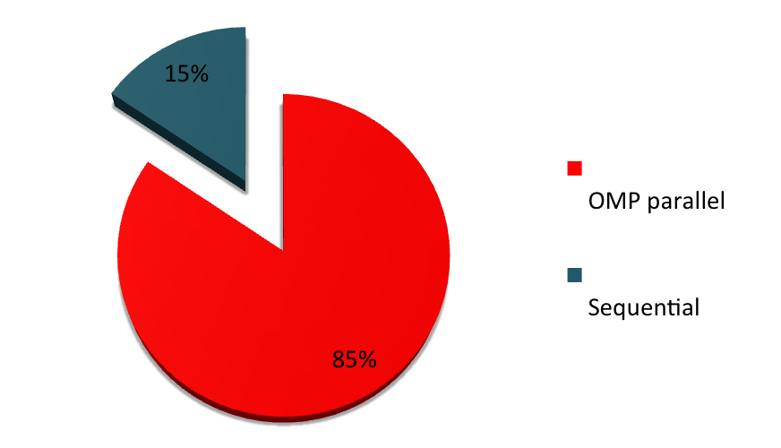
GYRE configuration
MODEL SETUP | GYRE
Resolution | 1/12° ~10Km
Grid dimension | 4322 x 2882 x 72
Number of grid points | 890M
Time Step | 3 min
Memory usage | ~ 1TB
The parallelization of the GYRE configuration required the analysis of:
30K lines of code
56 routines
Number of cores | Time (sec) | Speedup
PRC: 320 – THR: 1 | 640 | 1
PRC: 320 – THR: 2 | 390 | 1.64
PRC: 320 – THR: 4 | 287 | 2.23

